Slide 1
Web devs+1
Design Challenge
Make Umuzi better by making it a noise regulated space
Team members
Boitumelo Msiza
Godfrey Khwathisi
Masego Rhulani Moanakwena
Nontokozo Mbonani
Nuraan Barnes
Thabo Monamudi

Slide 2
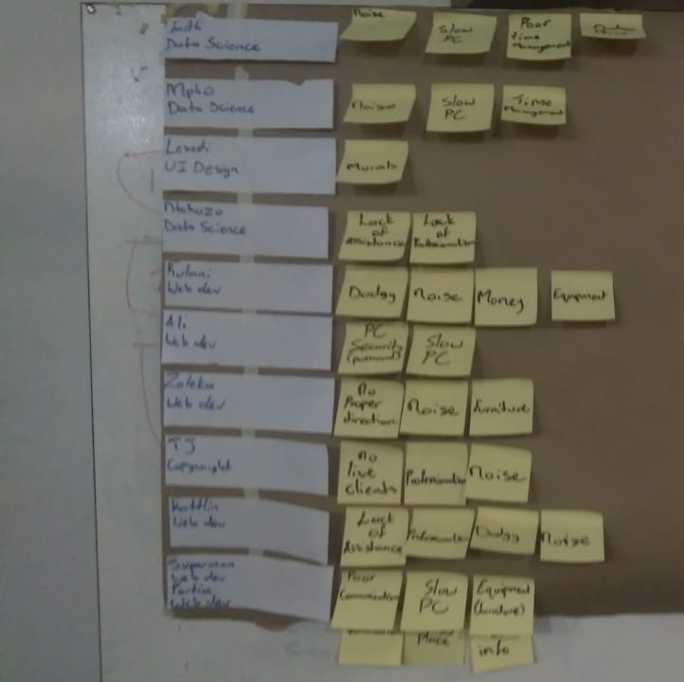
We asked a variety of questions and spoke to different departments.
We found out that there were alot of issues where we decided to then gather them all and then decided which to work on and prototype
Interviews conclusions and empathising with recruits

Slide 3
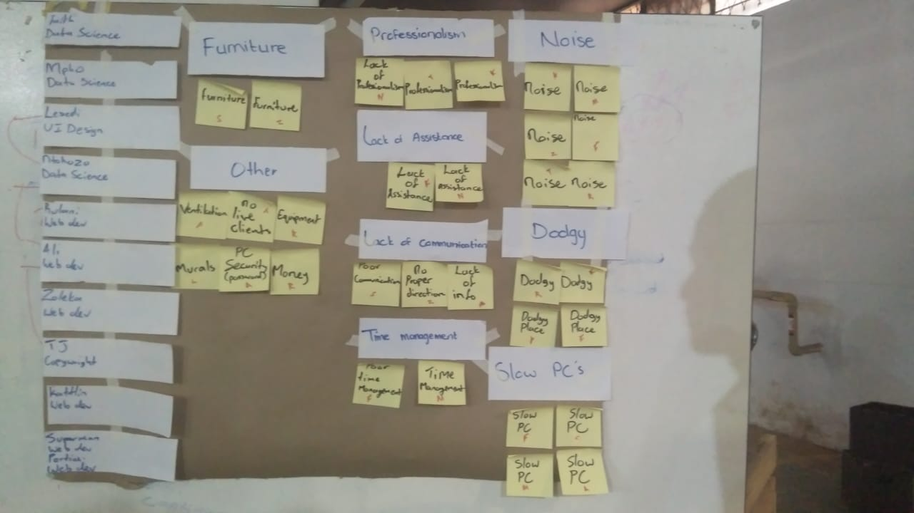
User Insights & Interviews
We got our insight from the interviews we did.we interviewed a variety of people,and from different departments. Different things were complaint about but noise has been a more challenging and we were able to have it regulated.

Slide 4
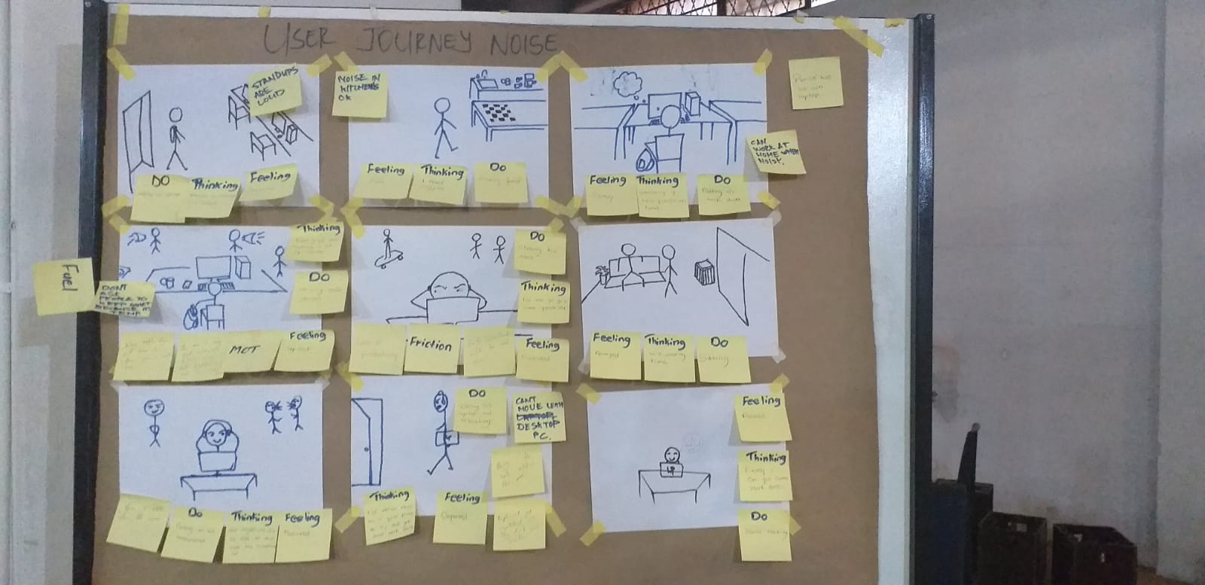
User Journey
We created a user by the name of Patrick,he is a 24 year old male,very committed to his work but can also be a distraction sometimes.he works in the tech department and have many deadlines.picture showing the frustration patrick goes through when he has work that he needs to finish

Slide 5
shows how he feel,what he thinks and what he does
All pictures had feelings,thinking and do to have a more understanding what the user went through.

Slide 6
Moments of Fuel, Friction & Truth
From the moment of truth where the recruit realise that it is too noisy,ended up having some friction where the recruit are unable to concentrate,to being all fueled up and getting a more quiet space to be productive.
But what was brought to our attention that everyone do not have there own laptop.

Slide 7
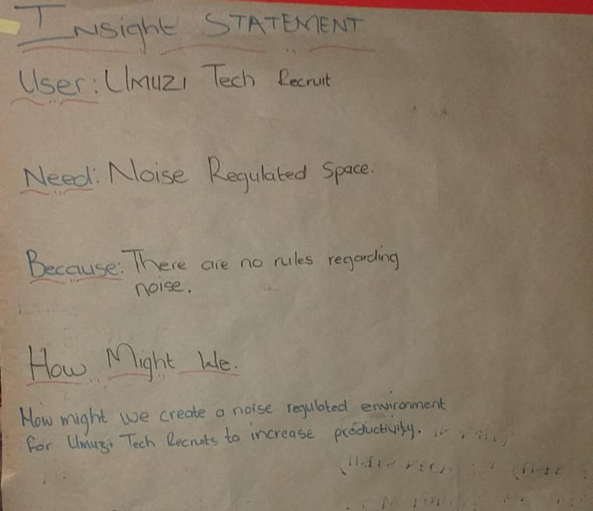
Our Insight Statement… How might we...
After we decided on our Moment of fuel, friction and true an insight statement was decided together with how we could possibly turn the user experience into a slightly better one.
Our insight statement: The place is too noisy to concentrate and get work done.
How might we...: create a noise regulated environment for Umuzi Recruits to increase productivity .

Slide 8
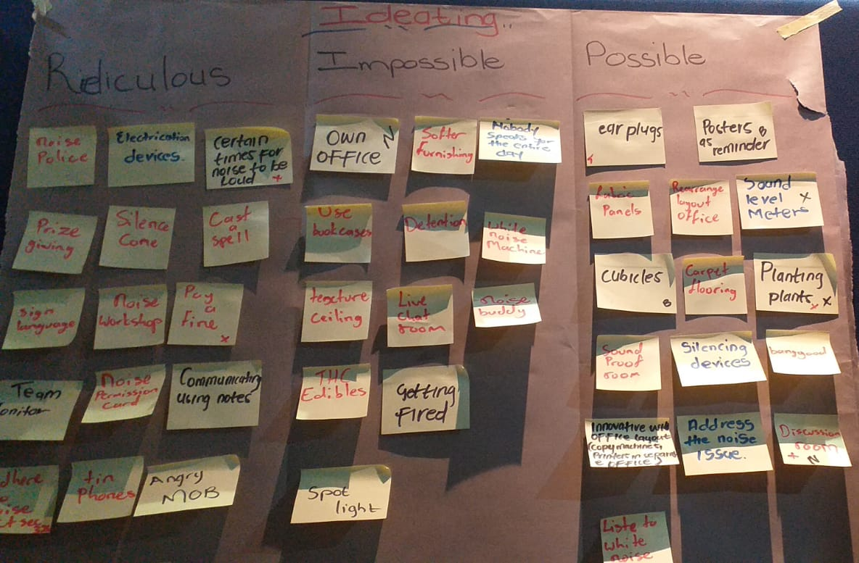
Brainstorm
We came up with a bunch of impossible and possible ideas that can be implemented around the concept of the layout in the office.
The main ideas were
- Cubicles
- Discussion rooms
- the rearrangement of the office

Slide 9
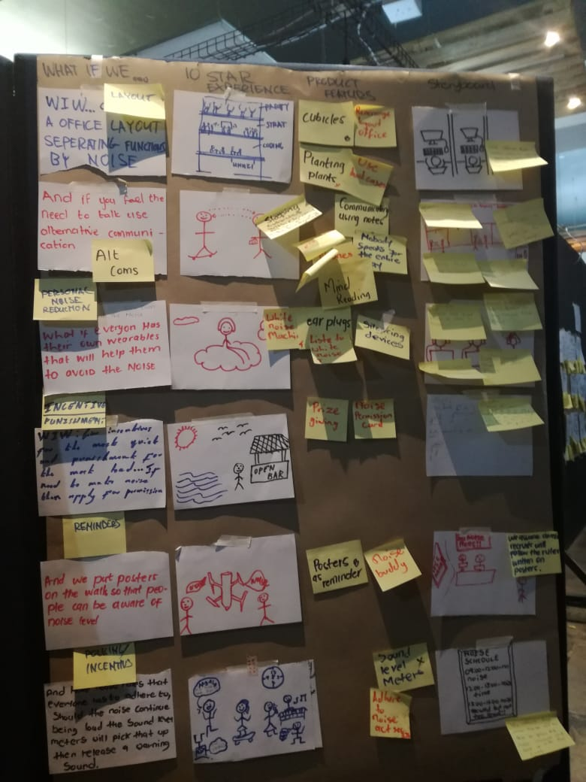
TEN Experience
With further investigating and asking more questions we then came to an conclusion that the cubicles will be a go to.
We had 6 different ideas where by we thought the recruits might find it realistic.

Slide 10
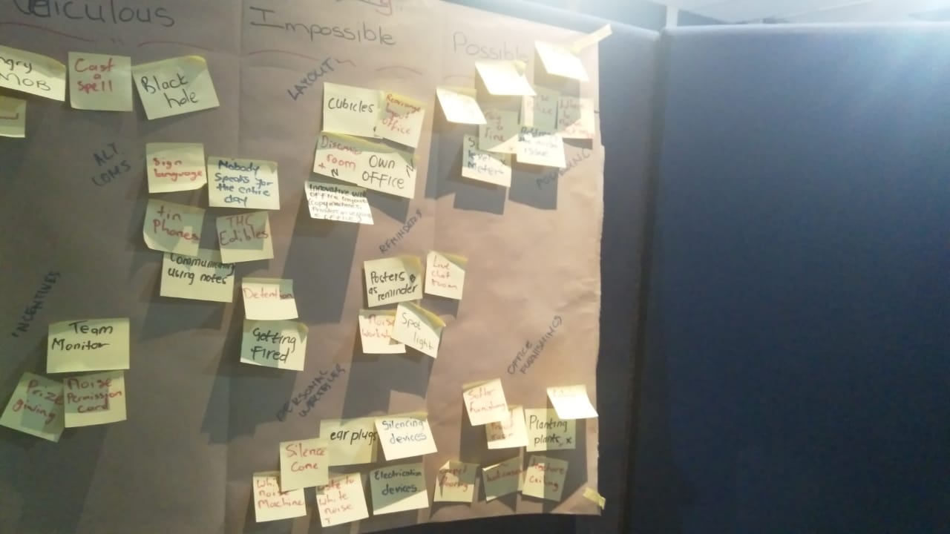
Idea to run with.
We ran through our ideas and ideated to the point we we bucketed certain suggestions in groups and came up with the possible solutions

Slide 11
Storyboard
Storyboards
With our story board we had different ideas,but by creating cubicles,
But then our results came back that they do not always want to feel that they have to be surrounded by cubicles.
They do not want to feel as if they working in a call centre

Slide 12
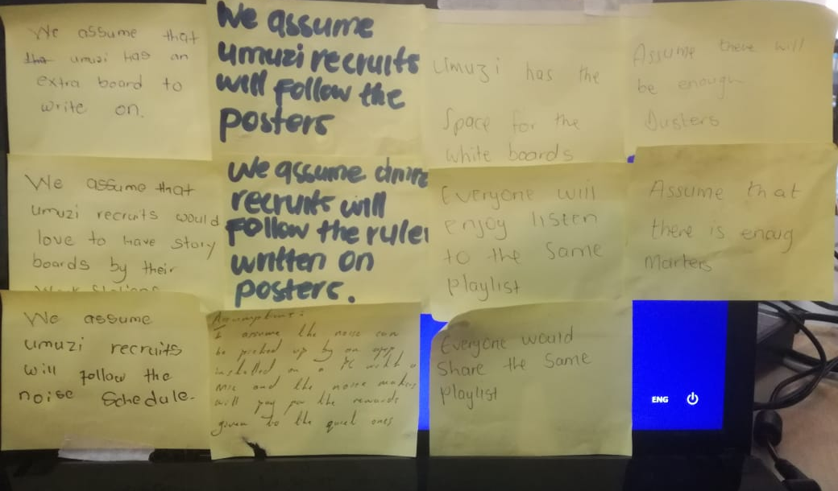
Key Assumptions, Tests & Results
- we assume that everyone at uMuzi wants to have their own office
- uMuzi recruits will feel comfortable working in cubicles
- assume that uMuzi recruits need a quiet space where they can work without being disturb
We assumed Umuzi recruits need:
Alot of things,but what we ended up seeing that it cost money and and not really valuable ,but we came to the point where we built our own cubicles that is removable and after the testing no one actually wanted to give it back

Slide 13
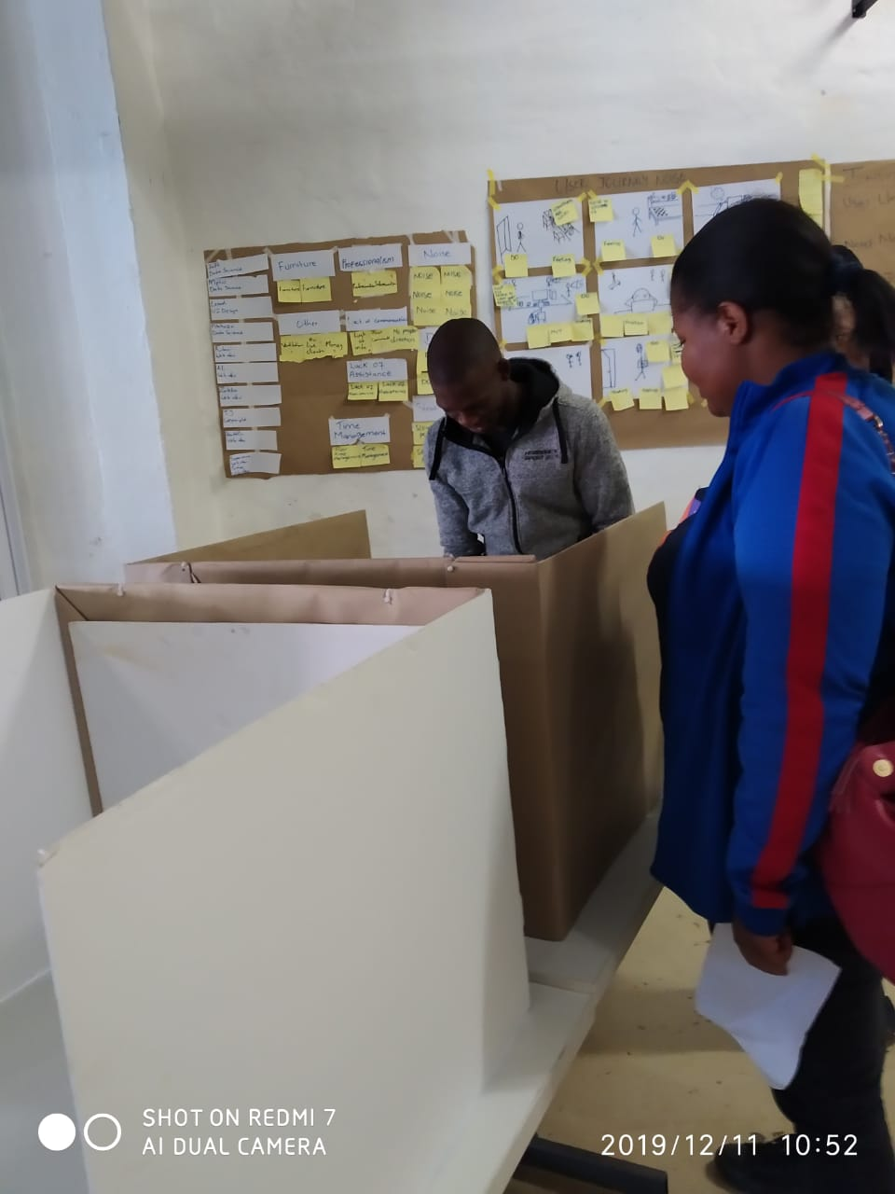
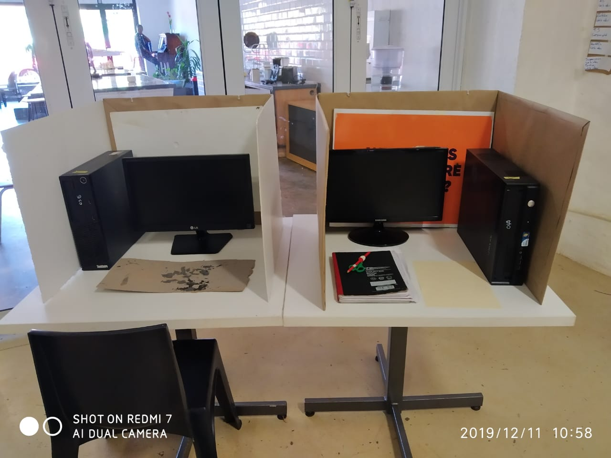
Our MVP & Results
After testing our project we held a presentation with what we have built
Outcomes
The session was successful, recruits digged it and we learned that it would be best to present live stations aswel as it will be pilled up on the floor for those who want to use it
With the common sense and humanity,when you see someone with a cubicle you will quiet down.
Within our presentation we accepted questions and suggestions.
Concluded off where we do not want to damage Umuzis culture and free space,hence the removable cubicles was a success.

